Slide 1
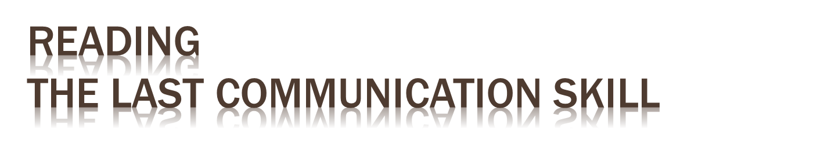
Department of Construction Management
Kris Kego
Sem 1 2015/16
CSC 1101

Slide 2
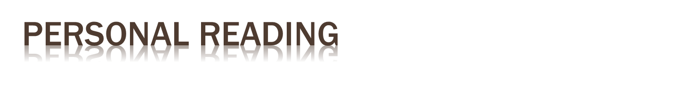
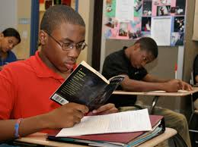

Slide 3
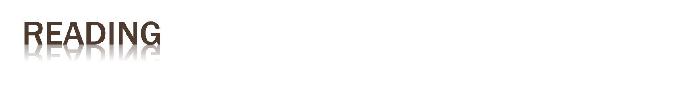
As we develop our skills in reading, the process often becomes more challenging
We are introduced to new vocabulary and more complex sentence structures
Early school textbooks offer us facts or ‘truths’ about the world which we are required to learn

Slide 4
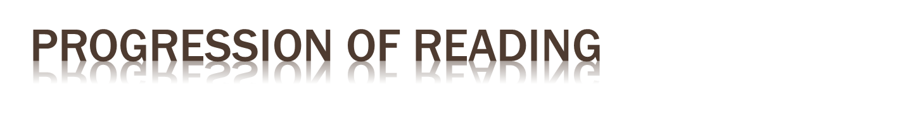
As schooling progresses, we learn to compare these perspectives and begin to form opinions about them
This change in reading from a surface approach (gathering facts) to a deep approach (interpreting) is essential in order to gain the most out of our studies

Slide 5
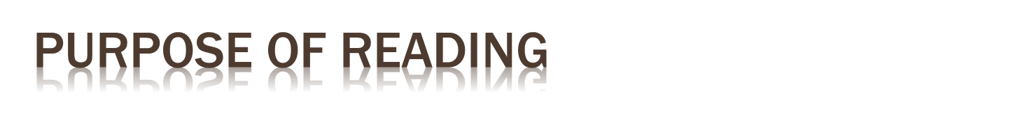
Reading becomes not simply a way to see what is said, but to recognize and interpret what is said, taking into account subtleties such as bias, assumptions and the perspectives of the author
Academic reading, therefore, means understanding the author’s interpretation of reality, which may be very different from our own

Slide 6
We read to gain factual information for practical use, for example, a train timetable or a cinema listing. For such documents we rarely need to analyse or interpret
We may also read fiction in order to be entertained; depending upon the reader, a level of interpretation may be applied

Slide 7
Many of us read newspapers and magazines, either in print or online, to inform us about current events. It is therefore easy to view a particular article as a statement of opinion rather than fact. Political biases, for example, are well know in the press

Slide 8
When reading academic material such as textbooks, journals and so on, you should be always reading to interpret and analyse
Nothing should be taken as fact or ‘truth’

Slide 9
When you read while studying an academic course, your principal goal will be to gather information in order to answer an assignment question or gain further information on a subject for an exam or other type of assessment.

Slide 10
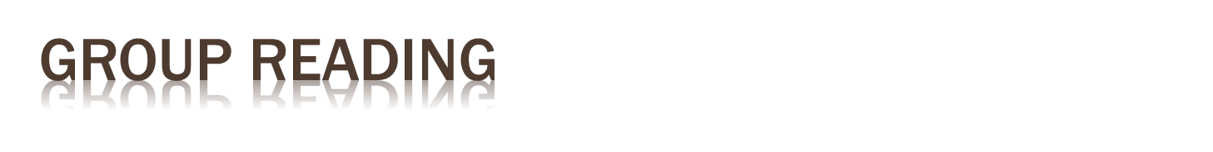
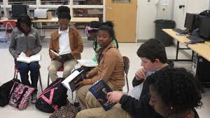

Slide 11
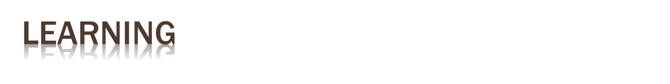
Underlying this is the more general theme of learning and development,
To develop your thoughts, to incorporate new ideas into your existing understanding, to see things from different angles or view-points, to develop your knowledge and understanding and ultimately yourself

Slide 12
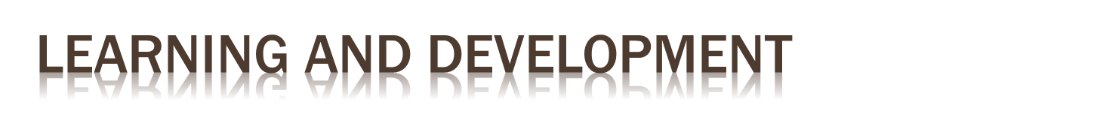
Learning, therefore, comes about not from reading and remembering details, but from developing your understanding of the meaning of the details
To engage with your ideas and opinions and rethink them in a positive and constructive way

Slide 13
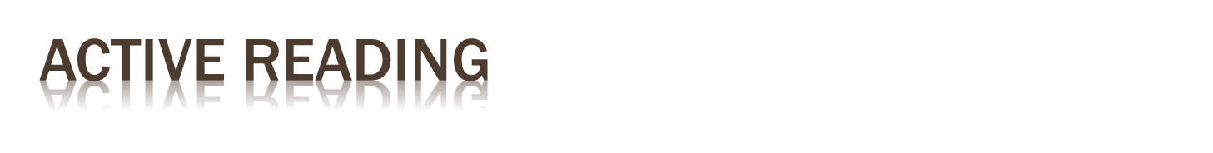
When you're reading a document or book in detail, it helps if you practice "active reading" by highlighting and underlining key information, and taking notes as you progress.
This emphasizes information in your mind, and helps you to review important points later
Doing this also helps you keep your mind focused on the material, and stops you thinking about other things

Slide 14
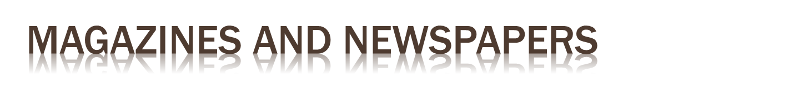
The most effective way of getting information from magazines is to scan the contents tables or indexes and turn directly to interesting articles
Newspapers tend to be arranged in sections. If you read a paper often, you can quickly learn which sections are useful, and which ones you can skip altogether

Slide 15
News Articles – these are designed to explain the key points first, and then flesh these out with detail. So, the most important information is presented first, with information being less and less useful as the article progresses.
Opinion Articles – these present a point of view. Here the most important information is contained in the introduction and the summary, with the middle of the article containing supporting arguments.
Feature Articles – these are written to provide entertainment or background on a subject. Typically the most important information is in the body of the text

Slide 16
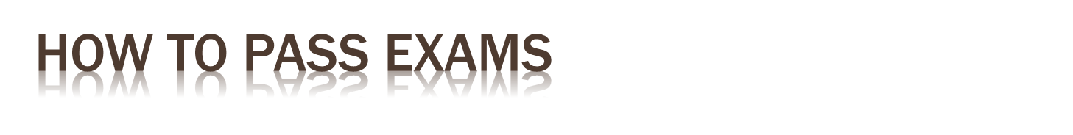
Ask the teacher
  Remember that your teacher is not your opponent or your nemesis: he or she is not out to frustrate you or irritate you but are always trying to help you
Beat the teacher
  Teachers will help you enormously, but ultimately it's your job and yours alone
  Understand the curriculum or syllabus you're studying and exactly what you're expected to know

Slide 17
Understand the marking scheme
  Understand how the marks are allocated. If you understand where your marks will come from, you can allocate your efforts accordingly
Plan your revision
  Find a pattern that works for you. One good tip is to make revision a habit: treat it like a job and make yourself revise between certain set times of the day whether you feel like it or not

Slide 18
Prioritize weak subjects
  Aim to revise everything but devote more time to things you don't understand or know less off
Be honest with yourself
  What are you good at and what are you bad at. Understand where you need to focus your efforts
Practice makes perfect
  Exams are theoretically a way of testing your knowledge and your understanding and the object of studying is to get a good education, not to pass exams
  Practicing exam questions and papers under time pressure is one of the best ways to improve your exam performance

Slide 19
Use memory aids
  When you had to remember the colors of the Rainbow (red orange yellow green blue indigo violet) “richard of york gave battle in vain”
Answer the question
  So take time to read and understand the questions on the exam paper & not the essay you just happen to have revised

Slide 20
Remember why you're studying
  You want to pass your exams, but don't forget that you're also trying to learn and understand things and get a good education

Slide 21
On Exam day
  Give plenty time for getting to the exam
  Don’t revise as you’re walking into the exam
  Read the question properly
  Spend the right amount of time on each question
  Explain each point as clearly as possible
  Set aside time for notes before you tackle the question
  Read over the answers when you’re done
  Present your work neatly
  Answer the questions in the order you want to
  Don’t panic
  When short on time, use bullet points

Slide 22
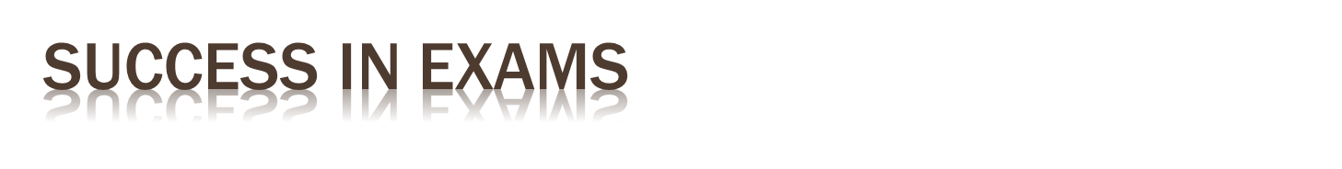


Slide 23
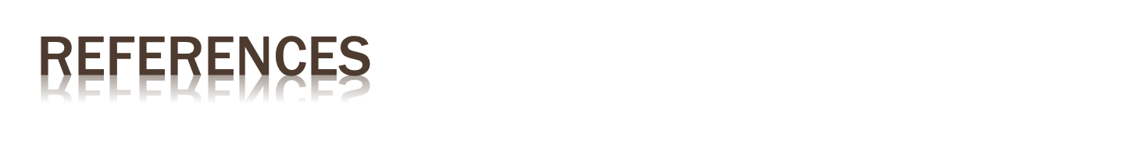
http://theuniversityblog.co.uk
http://www.kevinboone.net/exams.html
Porges, Stephen W. (2011). The Polyvagal Theory: Neurophysiological Foundations of Emotions, Attachment, Communication, and Self-regulation. New York: W. W. Norton & Company
http://www.dartmouth.edu/~acskills/success/notes.html
Sollier, Pierre (2005). Listening for Wellness: An Introduction to the Tomatis Method. The Mozart Center Press
Authors: Lawrence Robinson, Jeanne Segal, Ph. D., and Melinda Smith, M.A. Last updated: October 2015.

